Slide 1
Logistic Regression Steps
Spencer Pao

Slide 2

1) Start with: Linear Regression Equation

Slide 3
2) Logistic Function (1)
We know that :
We know that our Response value (y) is between 0 and 1

Slide 4
2) Logistic Function (2)
We know that :
We know that our Response value (y) is between 0 and 1
Thus, we transform our data such that it fits our criteria above

Slide 5

2) Logistic Function (3)
We know that :
We know that our Response value (y) is between 0 and 1
Thus, we transform our data such that it fits our criteria above
Logistic Function :

Slide 6
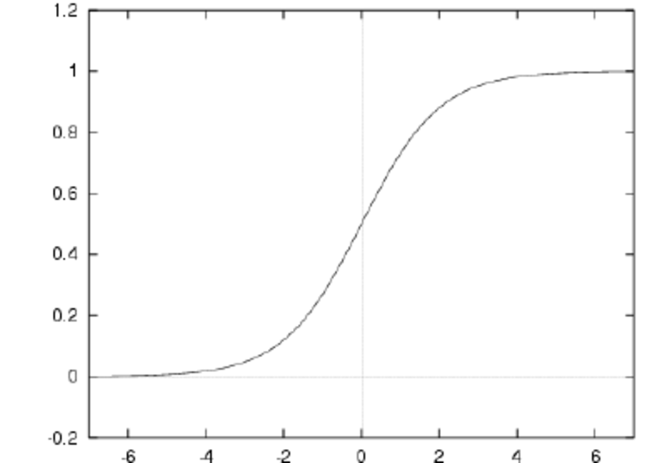

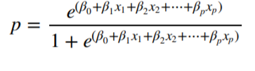
3) Sigmoid
Sigmoid Function on Linear Regression

Slide 7

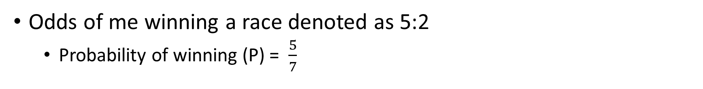
4) Odds and Odds Ratio
Odds of me winning a race denoted as 5:2
Probability of winning (P) = $\frac{5}{7}$
Plug Probability to get an Odds Ratio (OR)
OR > 4 is high
OR < ¼ is low

Slide 8

5) Logit Function (Log of Odds Ratio)
Interpretation: A unit increase in variable (X) results in multiplying the odds ratio by exponent to power β. Since our relationship is not a straight line, a unit change affects the odds ratio and not the output directly.

Slide 9
5) Logit Function (Log of Odds Ratio) (2)
Interpretation: A unit increase in variable (X) results in multiplying the odds ratio by exponent to power β. Since our relationship is not a straight line, a unit change affects the odds ratio and not the output directly.
Plot logit(P) on the Y axis and the event (X) on the X axis

Slide 10

6) Estimating Coefficients
Maximum Likelihood to determine best coefficients
Finds the values of the coefficients such that the predicted probabilities are as close to the real probabilities

Slide 11
7) Evaluating Logistic Regression
Akaike Information Criteria (AIC)
Bayesian Information Criteria (BIC)
Null Deviance and Residual Deviance
Confusion Matrix
Receiver Operator Characteristic (ROC)

